Slide 1
IBM University Engagement Project Submission
“Exploring the Power of Agentic AI with IBM Granite and IBM Bob”

Slide 2

Project Tile – ResearchAI – CS/DSA/AI-ML Research Paper Assistant
Domain of Project – EDUCATION
Student Name | Recent Passport Photo | Email ID | Mobile number [WhatsApp]
TEJAS TYAGI |  | tejastyagi1107@gmail.com | 8178834753
Recommended font style and size:
Font Style: Arial
Font Size (Heading): 28
Font Size (Content): 20

Slide 3
Problem Statement -
Problem Statement : RESEARCH AGENT
The Challenge
Students struggle to extract clear understanding from dense academic papers and technical documentation on algorithms, data structures, and AI/ML research. Information is scattered across lengthy papers, written in dense jargon, and time-consuming to synthesize manually. Without accessible, beginner-friendly explanations, many learners find it difficult to grasp core contributions, methodologies, and complexity analysis quickly.
The Objective
Build an AI-powered Research Agent that helps students and researchers understand computer science literature — specifically algorithms, DSA, and AI/ML papers — using IBM watsonx.ai and Granite models. The solution should:
Paper Ingestion & RAG Retrieval – Accept uploaded PDFs or pasted text, chunk and embed content into a vector database (FAISS) for fast, accurate retrieval
Auto-Summarization – Generate structured summaries highlighting core contributions, key algorithms, and complexity analysis
Concept Explainer – Explain any CS/AI/ML concept in simple, beginner-friendly language with step-by-step breakdowns
Grounded Q&A Chat – Answer natural language questions about the paper's content, with citations to the exact section the answer came from
Multi-Agent System
Retrieval Agent (chunks and indexes paper content)
Summarization Agent (generates structured summaries)
Concept Explainer Agent (beginner-friendly explanations)
Q&A Agent (grounded conversational retrieval with citations)

Slide 4
Proposed Solution -
Proposed Solution -
The proposed solution is a multi-agent Research Paper Assistant built using IBM Bob, IBM Granite, and watsonx.ai. The system helps students and researchers quickly understand dense CS/DSA/AI-ML literature through automated summarization, concept explanation, and grounded Q&A.
At its core, the solution uses a Retrieval-Augmented Generation (RAG) pipeline: uploaded papers are parsed, chunked, and embedded into a FAISS vector database, enabling accurate semantic retrieval of relevant content for any query.
Paper Ingestion Agent extracts and processes PDF content, chunking it for efficient retrieval and embedding.
Summarization Agent generates structured summaries covering core contributions, key algorithms, and complexity analysis.
Concept Explainer Agent breaks down any CS/AI/ML concept into simple, beginner-friendly, step-by-step explanations — independent of any uploaded paper.
Q&A Agent answers natural language questions grounded in the retrieved paper content, citing the exact section each answer comes from to ensure transparency and trust.
The solution offers a clean, multi-page web interface (Home, Upload Paper, Chat/Q&A, Summary View, Concept Explainer) built with Flask, allowing users to interact with the agent system in real time, backed by watsonx.ai for language generation.
Overall, the solution transforms static, hard-to-parse research papers into an interactive learning experience, making advanced CS concepts accessible to students at any level.

Slide 5
Technology Used
Technology Used -
IBM Bob – For designing, generating, and orchestrating the full-stack Research Agent application (Flask backend + frontend) through natural language prompts
IBM watsonx.ai SDK – Used to connect and authenticate the application with IBM's AI infrastructure
LLM (meta-llama/llama-3-3-70b-instruct) – For natural language understanding, summarization, concept explanation, and grounded Q&A generation
RAG (Retrieval-Augmented Generation) – Ensures responses are grounded in the actual uploaded paper content rather than relying purely on model knowledge, improving accuracy and trustworthiness
FAISS Vector Database – For storing and retrieving semantically relevant paper chunks efficiently

Slide 6
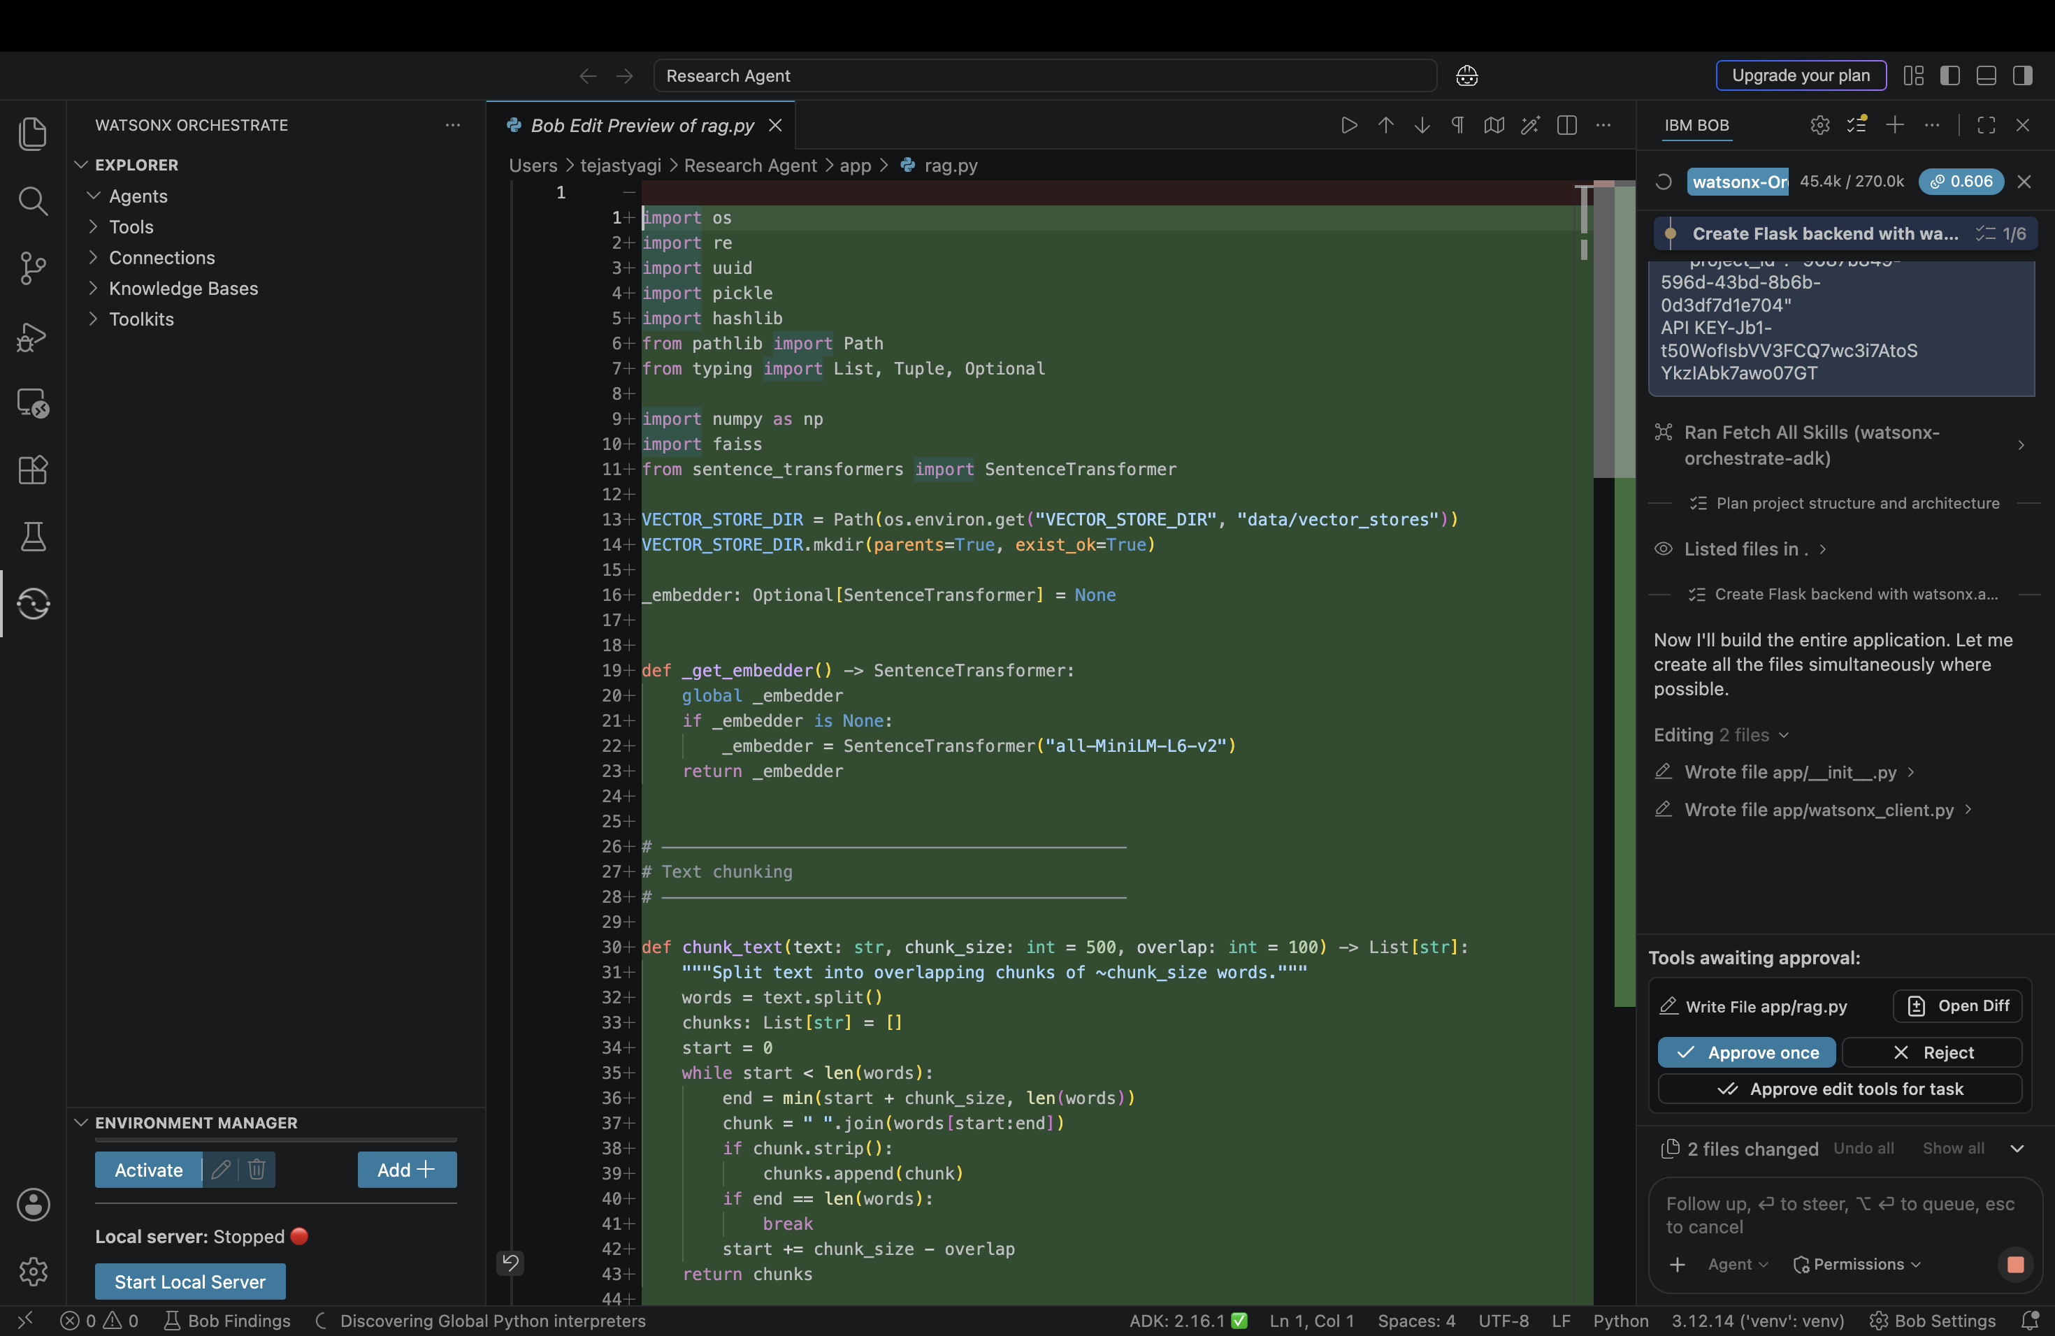
Required Files created using IBM bob -

Slide 7
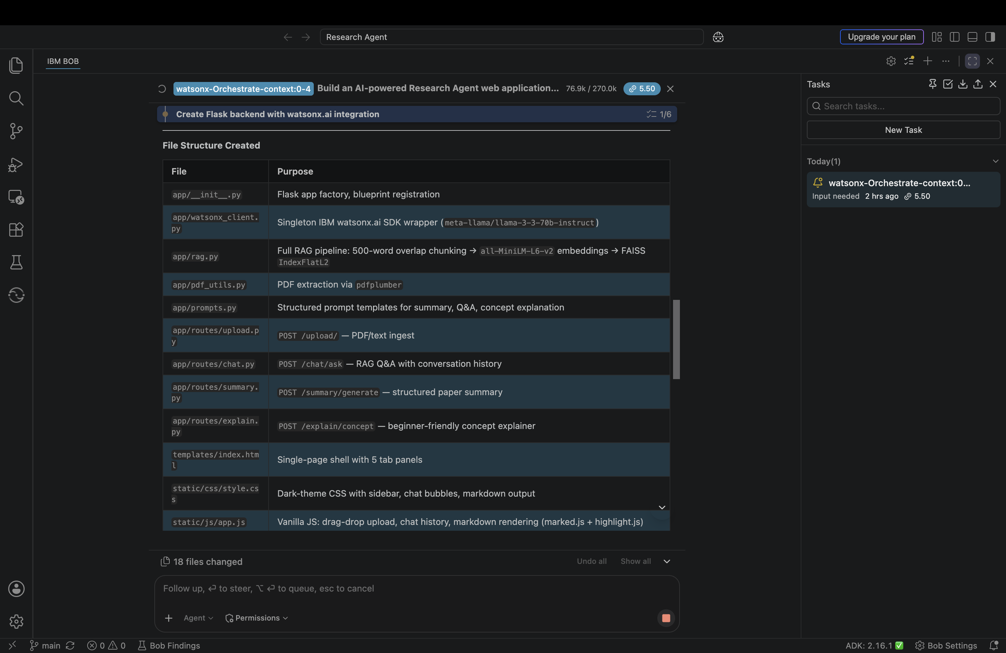
IBM Bob Screenshots:

Slide 8
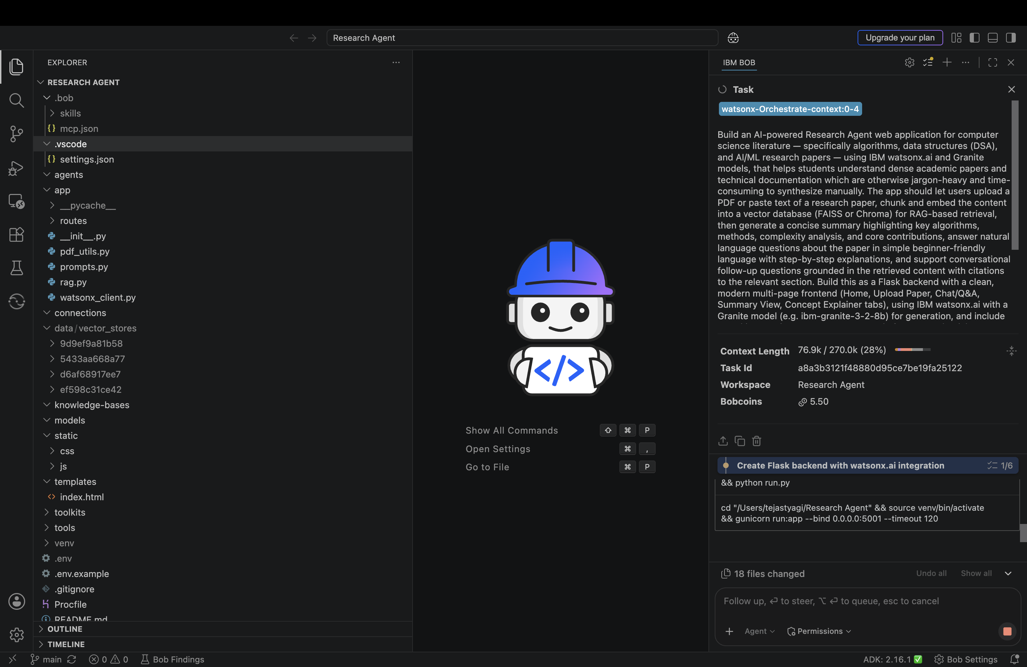

Slide 9
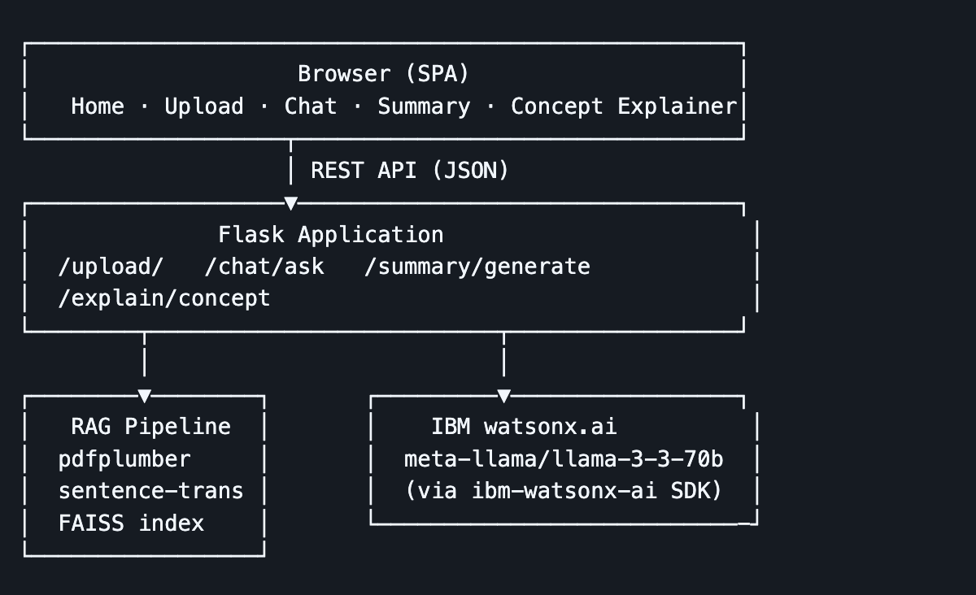
Architecture blueprint for IBM bob:

Slide 10

Role of Agentic AI in the solution
Role of Agentic AI in the Solution
Agentic AI enables the Research Agent to function as an intelligent, autonomous system rather than a simple chatbot. Using IBM watsonx.ai, it coordinates multiple specialized agents to deliver accurate, grounded research assistance.
Each agent performs a specific role — retrieving and chunking paper content, generating structured summaries, explaining concepts in beginner-friendly language, and answering grounded questions — while working collaboratively. This multi-agent approach ensures efficient task execution and accurate, citation-backed results.
Agentic AI also brings context awareness, understanding the content of the uploaded paper to generate relevant, grounded responses rather than generic answers. It supports real-time interaction, allowing users to ask follow-up questions and receive answers instantly.
Additionally, the RAG pipeline ensures every answer is grounded in the actual paper content, with citations to the exact section — reducing hallucination and improving trust.
Overall, Agentic AI makes the system proactive, accurate, and research-focused, acting like a personal research assistant that helps students and researchers understand dense academic literature quickly and reliably.

Slide 11
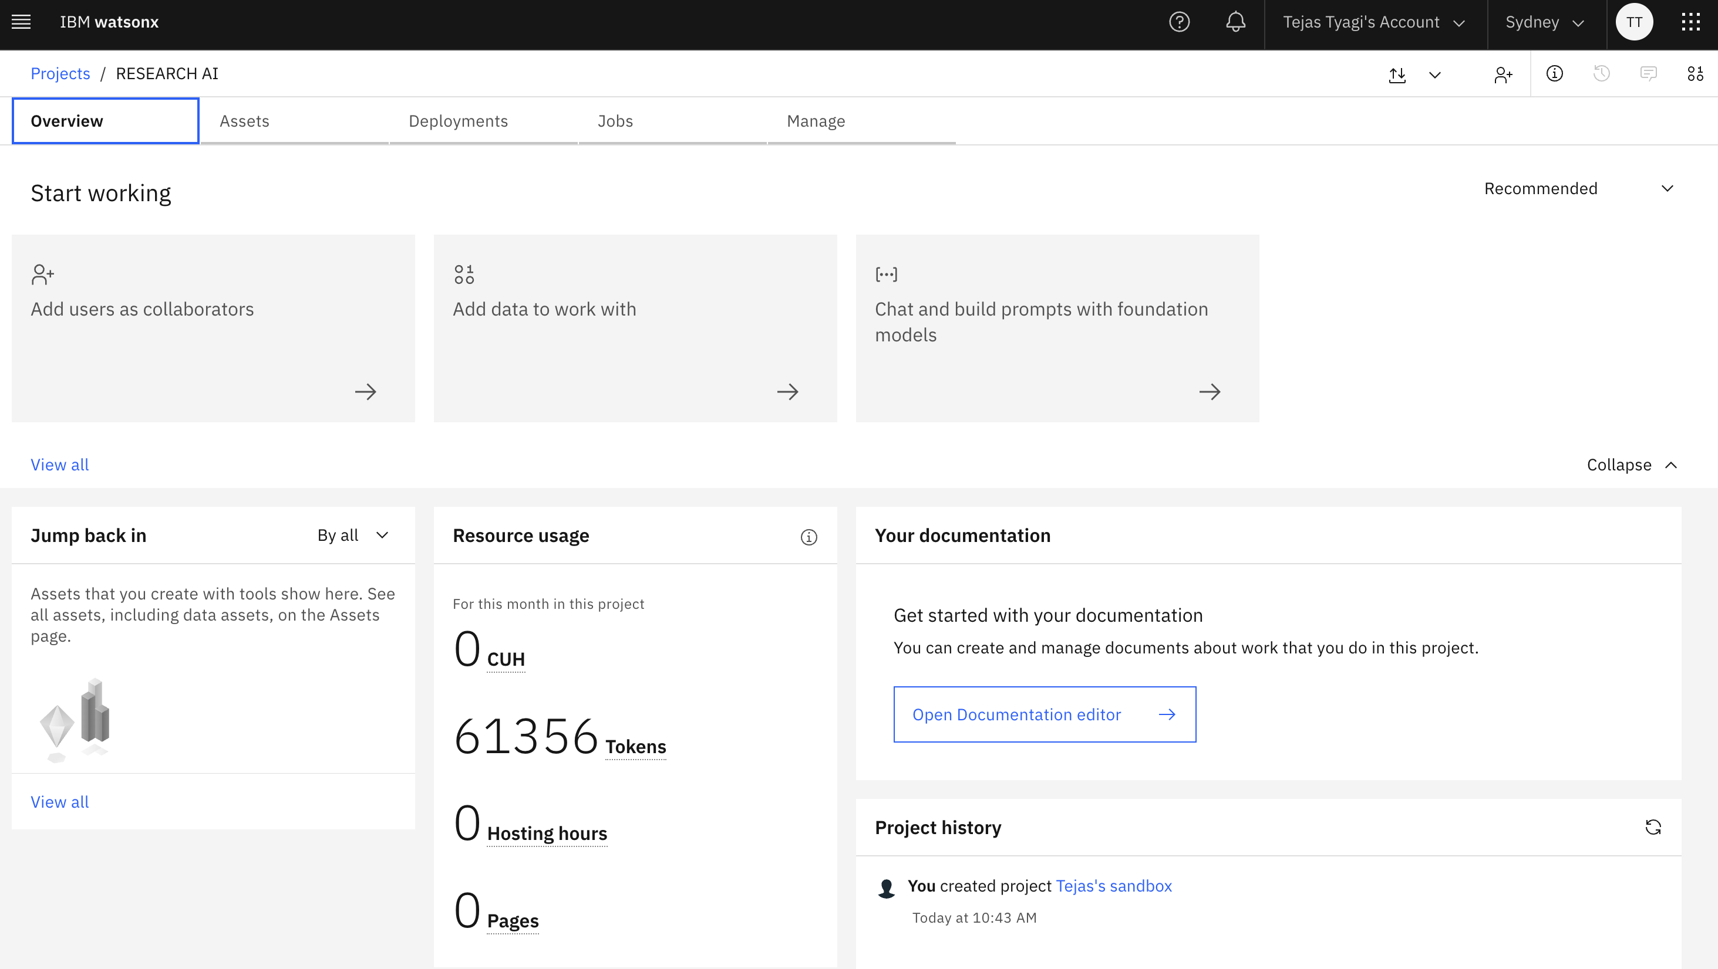
Token Usage
·
·
·

Slide 12
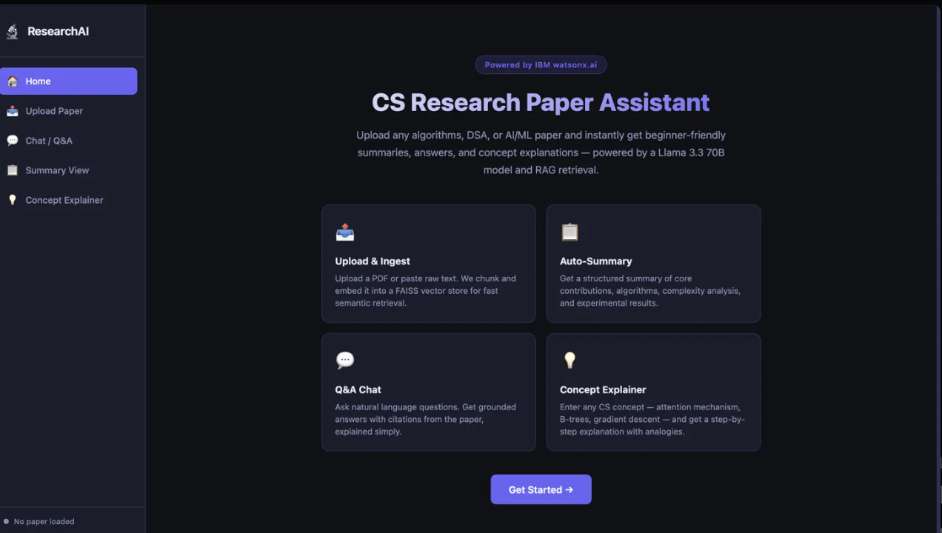
Project Output Screenshot
·
·
·

Slide 13
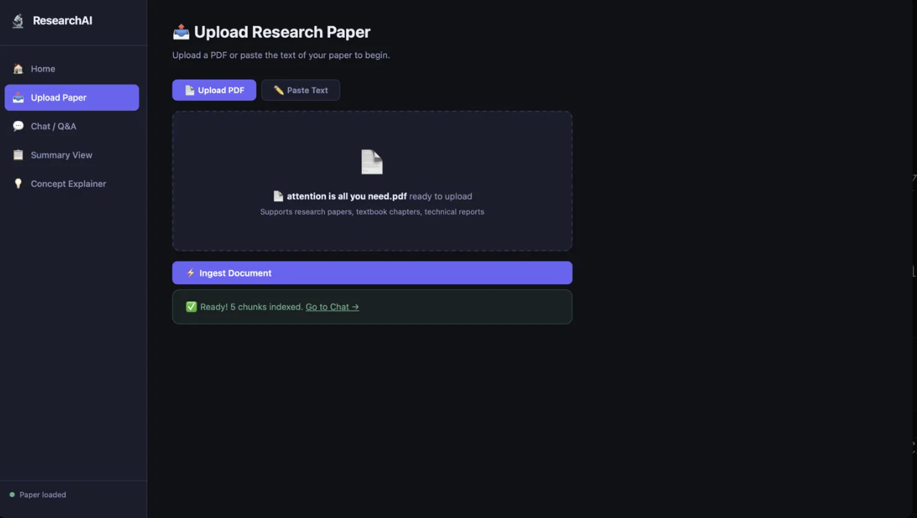
Project Output Screenshot
·
·
·

Slide 14
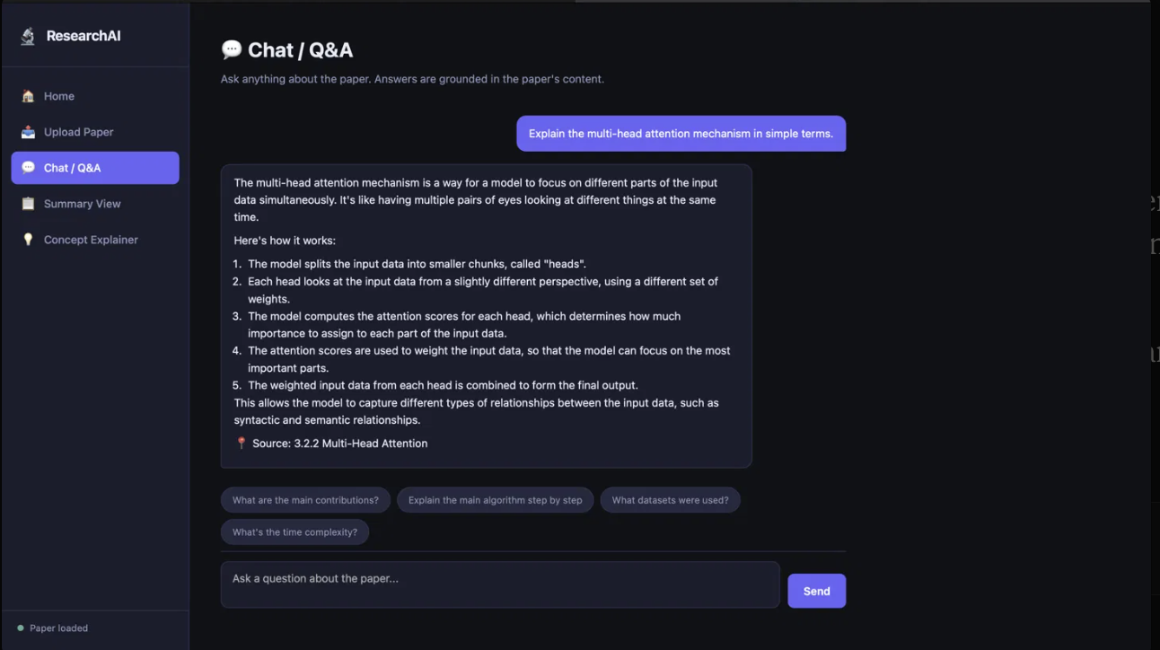
Project Output Screenshot
·
·
·

Slide 15
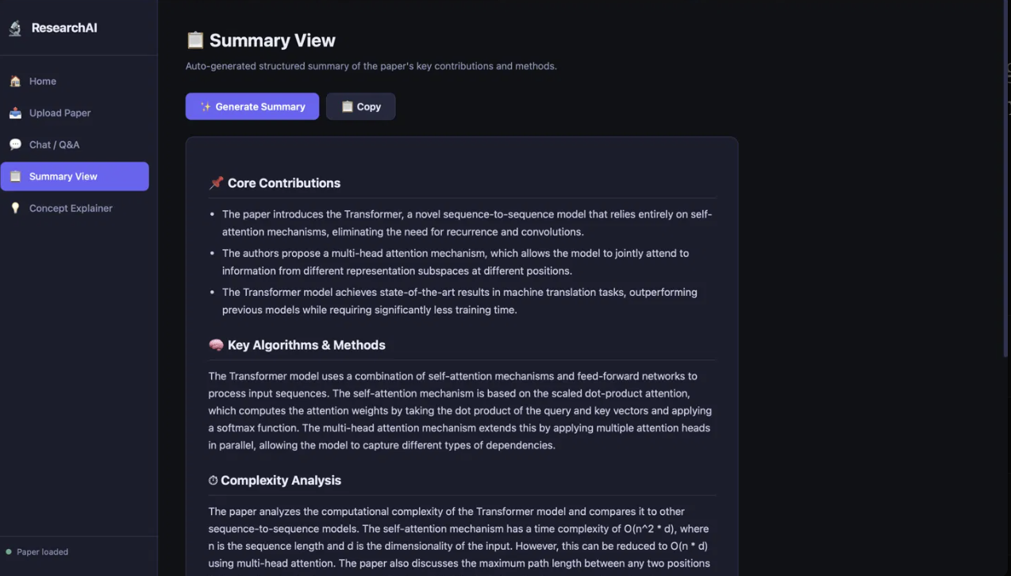
Project output screenshot

Slide 16
Novelty and Uniqueness
The proposed Research Agent stands out by combining Agentic AI, RAG, and beginner-friendly explanation into a single intelligent system.
Multi-Agent Intelligence – Instead of a single chatbot, specialized agents collaborate to deliver accurate, grounded, and well-structured research assistance.
RAG-Based Accuracy – Integrates retrieval from the actual uploaded paper with AI generation, reducing hallucination and grounding every answer in citable content.
Concept-Level Explainability – Goes beyond summarization to explain any CS/AI/ML concept in simple, beginner-friendly, step-by-step language — independent of any specific paper.
Citation-Grounded Q&A – Every answer references the exact section of the paper it came from, ensuring transparency and trust.
Dual-Domain Coverage – Supports both algorithms/DSA literature and AI/ML research papers, making it useful across core computer science topics.
Scalable & Deployment-Ready – Built with IBM watsonx.ai, containerized with a clean Flask architecture, ready for deployment on IBM Cloud or other platforms.
This makes the solution a smart, adaptive research companion, not just a static summarization tool.

Slide 17
Git Hub Link
· Please create public github repository (Enable Add README button while creating repository) with format –
Please test and Paste the working Github URL –https://github.com/tejastyagi1107-cpu/research-agent
Make sure you have Uploaded following three files into your github repository
1) All Agent relevant files of IBM Cloud , 2) yourproblemstatement.pdf file 3) your projectpresntation.pptx file 4)any other files
·
·
·

Slide 18
Future Scope
1. Multi-Source Literature Search –
Extend the system to search and pull papers directly from arXiv or Google Scholar, instead of requiring manual upload.
2. Cross-Paper Comparison –
Compare multiple papers side-by-side and generate citation graphs to help researchers understand connections between papers faster.
3. Voice Input & Multilingual Support –
Add voice interaction and multi-language support to make the tool accessible to a wider range of students.
4. Personalized Learning Paths –Track concepts a user has explored and recommend related papers to build a structured learning journey.
·
·
·

Slide 19
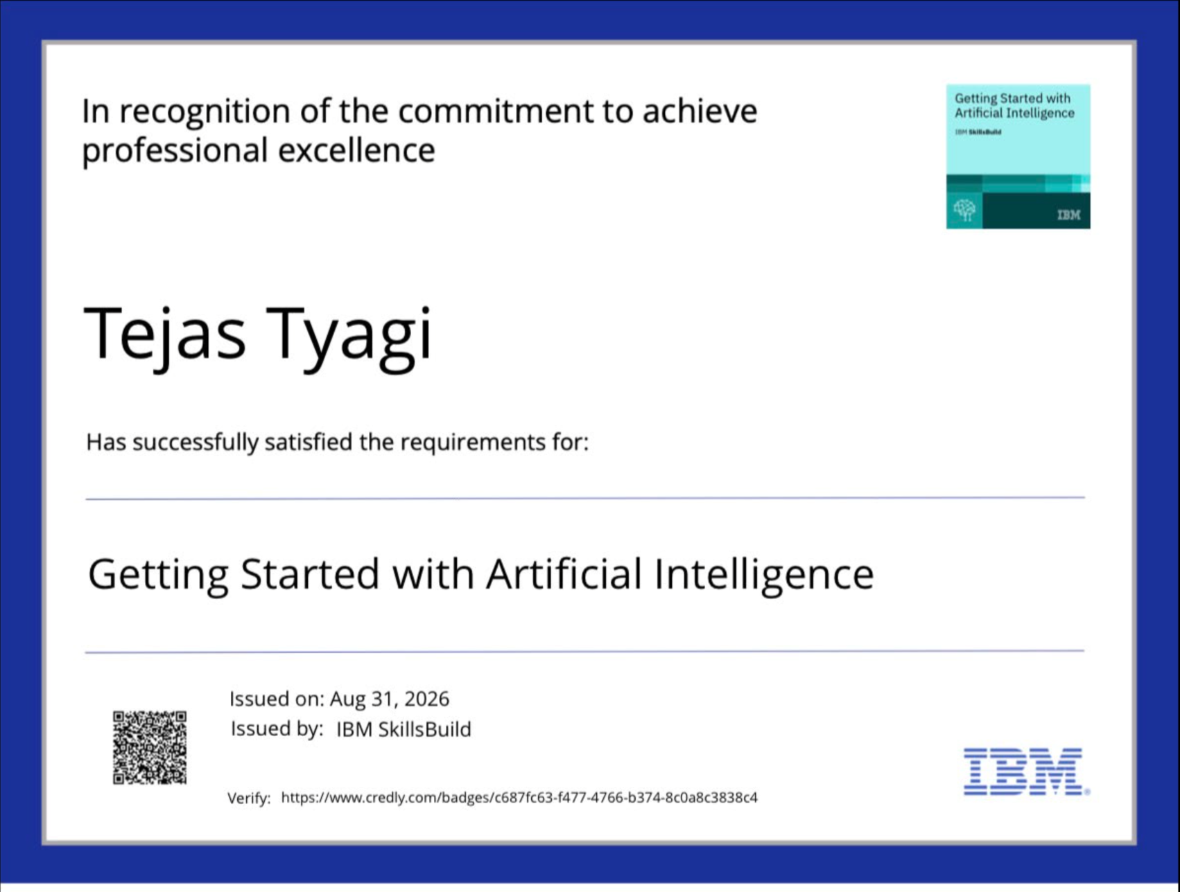
Certificates Earned:
Please add your credly certificate(Getting Started with Artificial Intelligence)

Slide 20
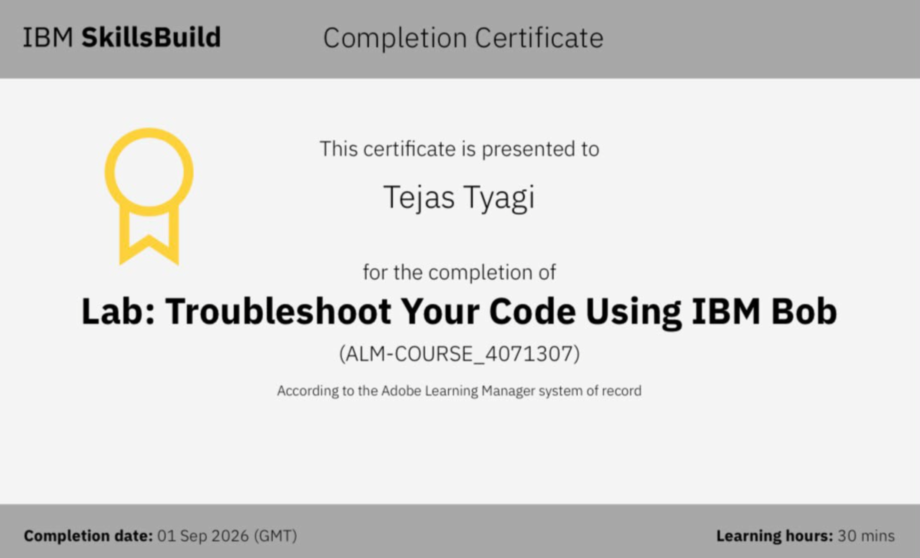
Certificates Earned:​
Add your IBM BOB Certificate

Slide 21


